Slide 1


SAVEETHA INSTITUTE OF MEDICAL
AND TECHNICAL SCIENCES
Capstone project presentation
FINSENSE AI- REALTIME SPENDING BEHAVIOUR INVESTMENT NUDGE ENGINE
CSA1712– ARTIFICIAL INTELLIGENCE
GUIDED BY
Dr.R.VEERAMANI
PRESENTED BY
VARSHINI M (192511215)
YUVASRI S (192511202)
LAKSHANA K (192524433)

Slide 2

INTRODUCTION
FinSense AI is an intelligent financial assistant for real-time spending analysis.
It monitors and analyses user transactions and spending behaviour.
Transactions are automatically categorised based on spending patterns.
AI identifies overspending and potential savings opportunities.
The system provides personalised financial and investment nudges.

Slide 3
ABSTRACT
FinSense AI combines real-time transaction processing, AI-based behaviour analysis and financial nudges.
It categorises transactions and identifies spending patterns and unnecessary expenses.
The system detects savings opportunities from user spending behaviour.
Personalised nudges encourage users to convert small savings into investments.
Goal tracking and gamification encourage consistent saving and long-term financial habits.

Slide 4

PROBLEM STATEMENT
People often overspend without realising their spending behaviour.
Traditional finance applications mainly provide reports after spending occurs.
Investment decisions are often delayed or ignored.
Small daily savings opportunities are frequently lost.
Existing systems provide limited personalised financial guidance.
Users need timely financial suggestions before poor spending habits develop.

Slide 5
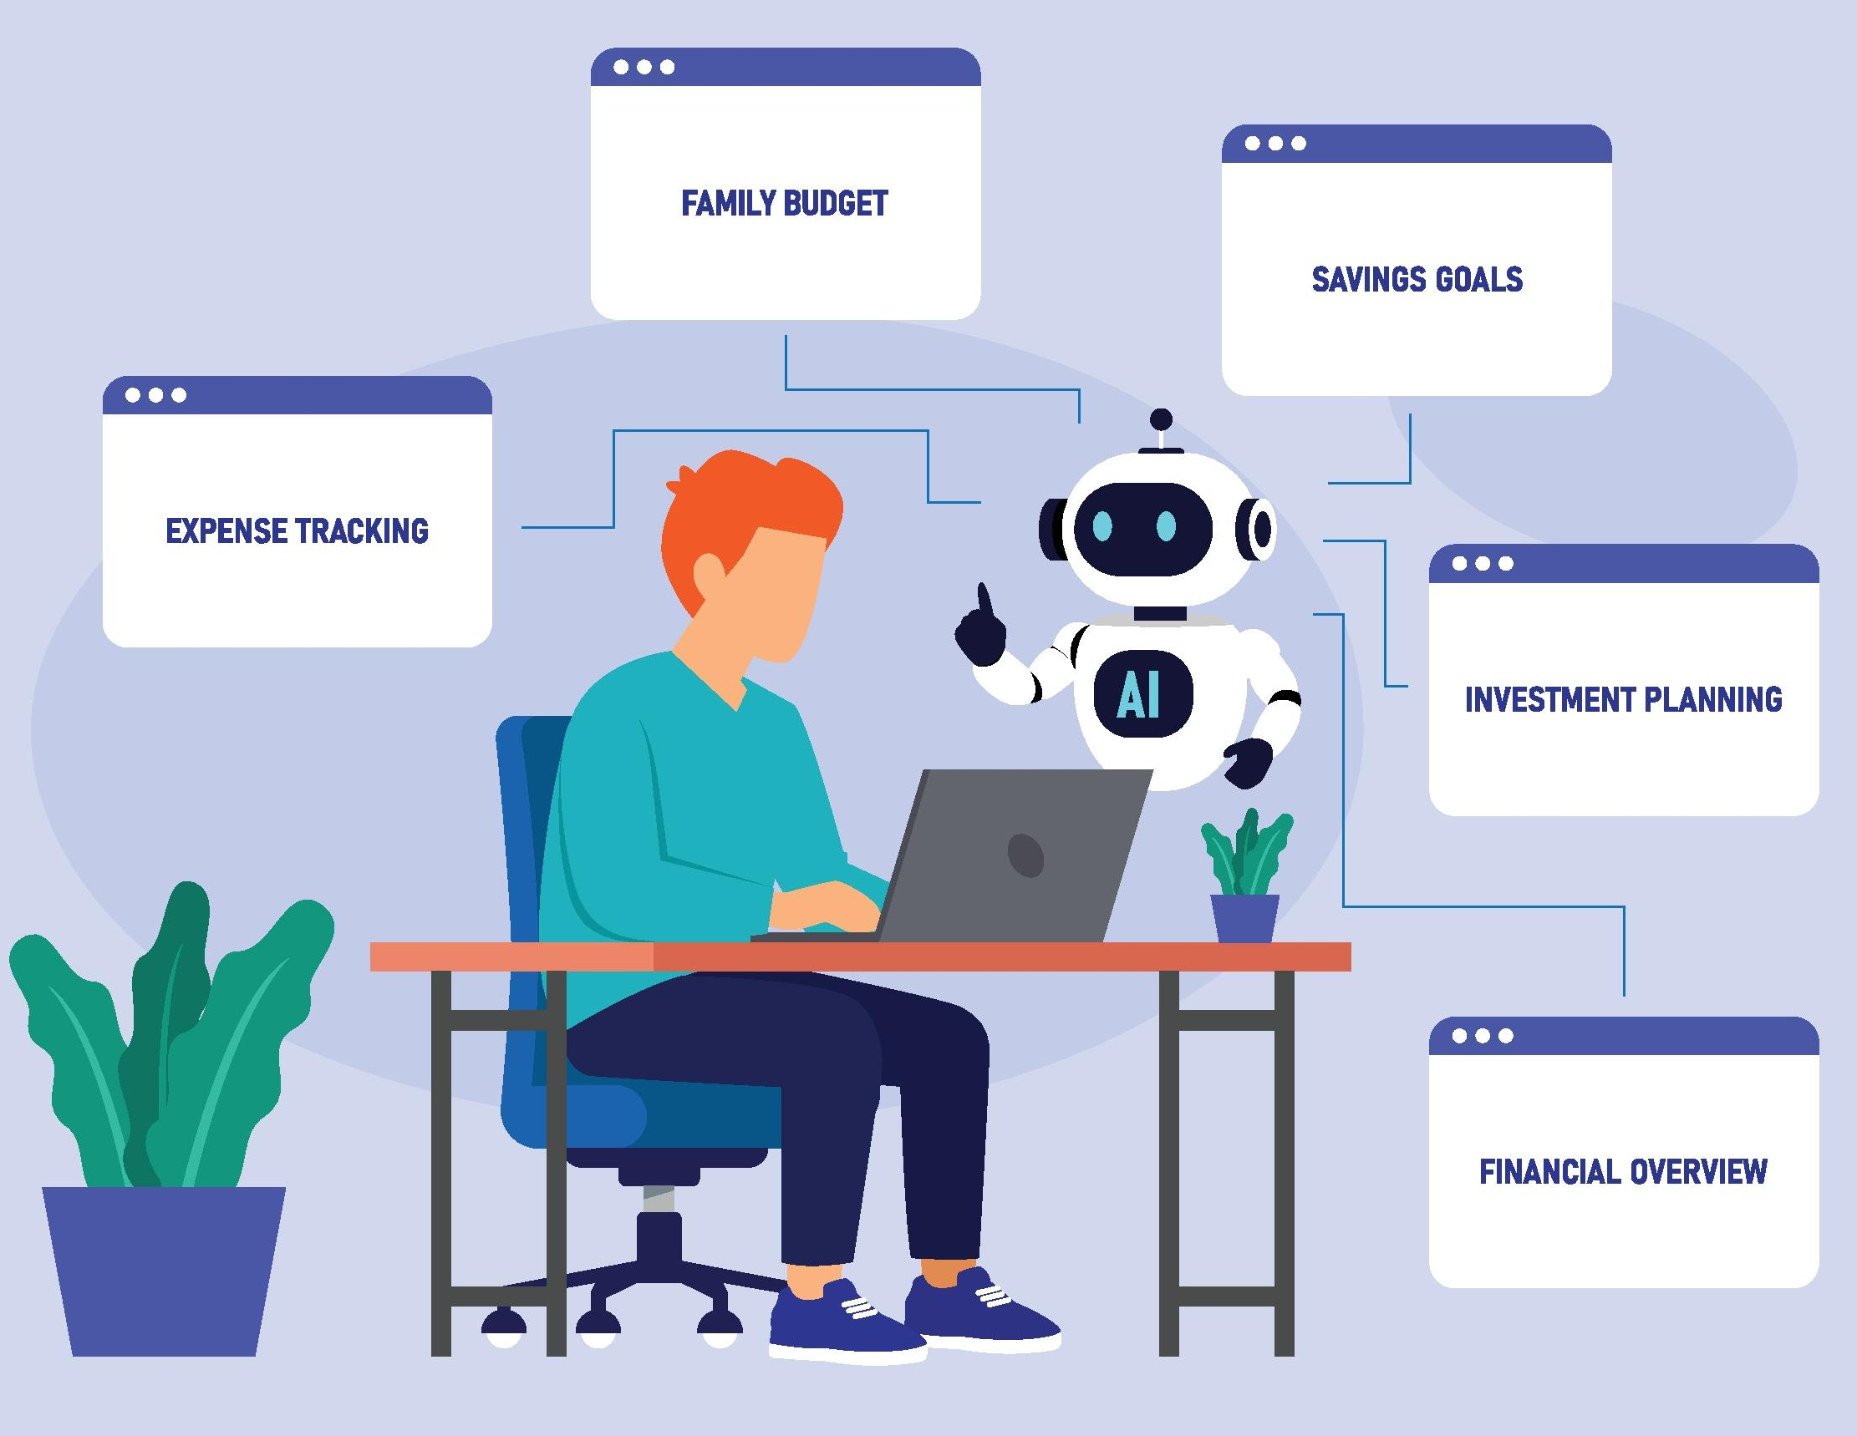
OBJECTIVES
Analyse Spending in Real Time – Monitor and categorise transactions as they occur.
Analyse User Behaviour – Identify spending patterns, overspending and recurring expenses.
Provide Personalised Nudges – Suggest suitable saving and investment actions.
Encourage Micro-Investments – Convert small savings opportunities into regular investments.
Build Better Financial Habits – Use goals, milestones and streaks to encourage consistency.

Slide 6
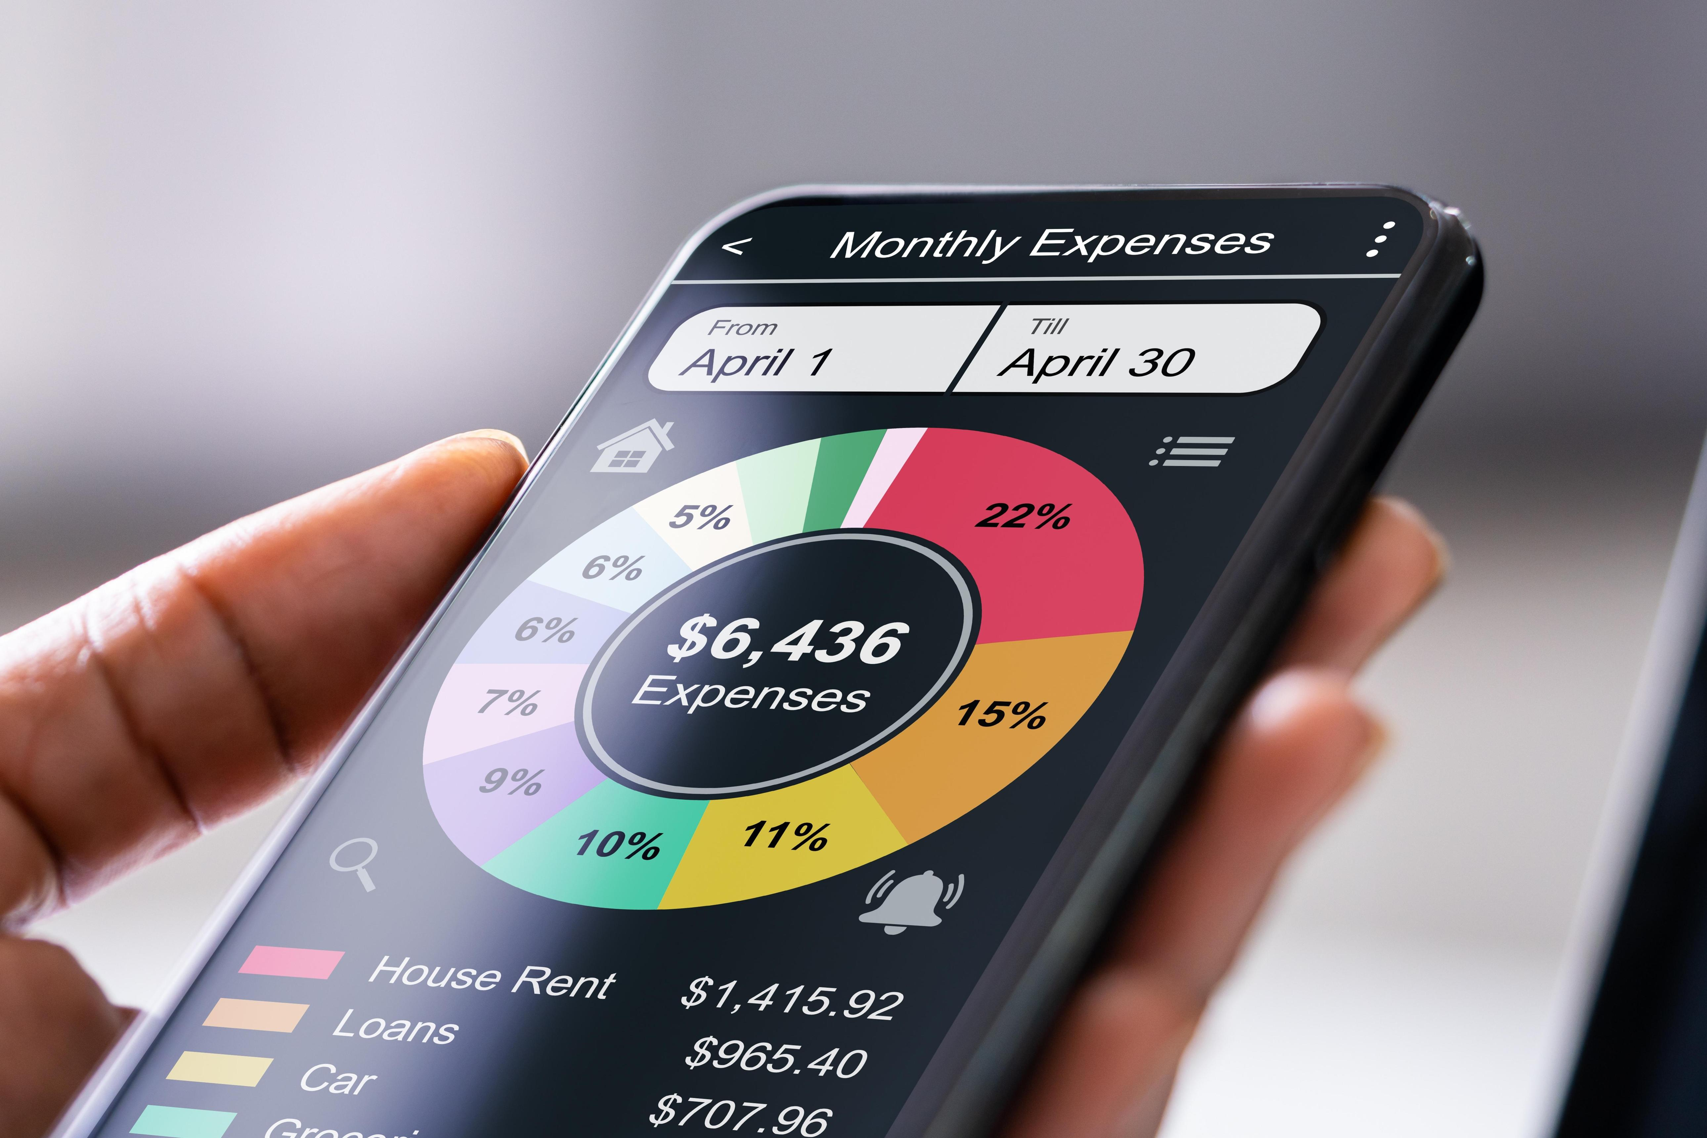
EXISTING SYSTEM
Existing personal-finance applications mainly provide:
Expense tracking
Transaction categorisation
Monthly spending reports
Budget monitoring
Budget-limit alerts
Manual investment planning
Main focus: Understanding past financial activity rather than providing continuous proactive guidance.

Slide 7
EXISTING SYSTEM DRAWBACK
Reactive rather than predictive
Alerts may appear only after overspending
Limited spending behaviour analysis
No timely AI-based investment suggestions
Small savings opportunities may be ignored
Limited personalised financial guidance
Limited gamification and goal-based motivation

Slide 8
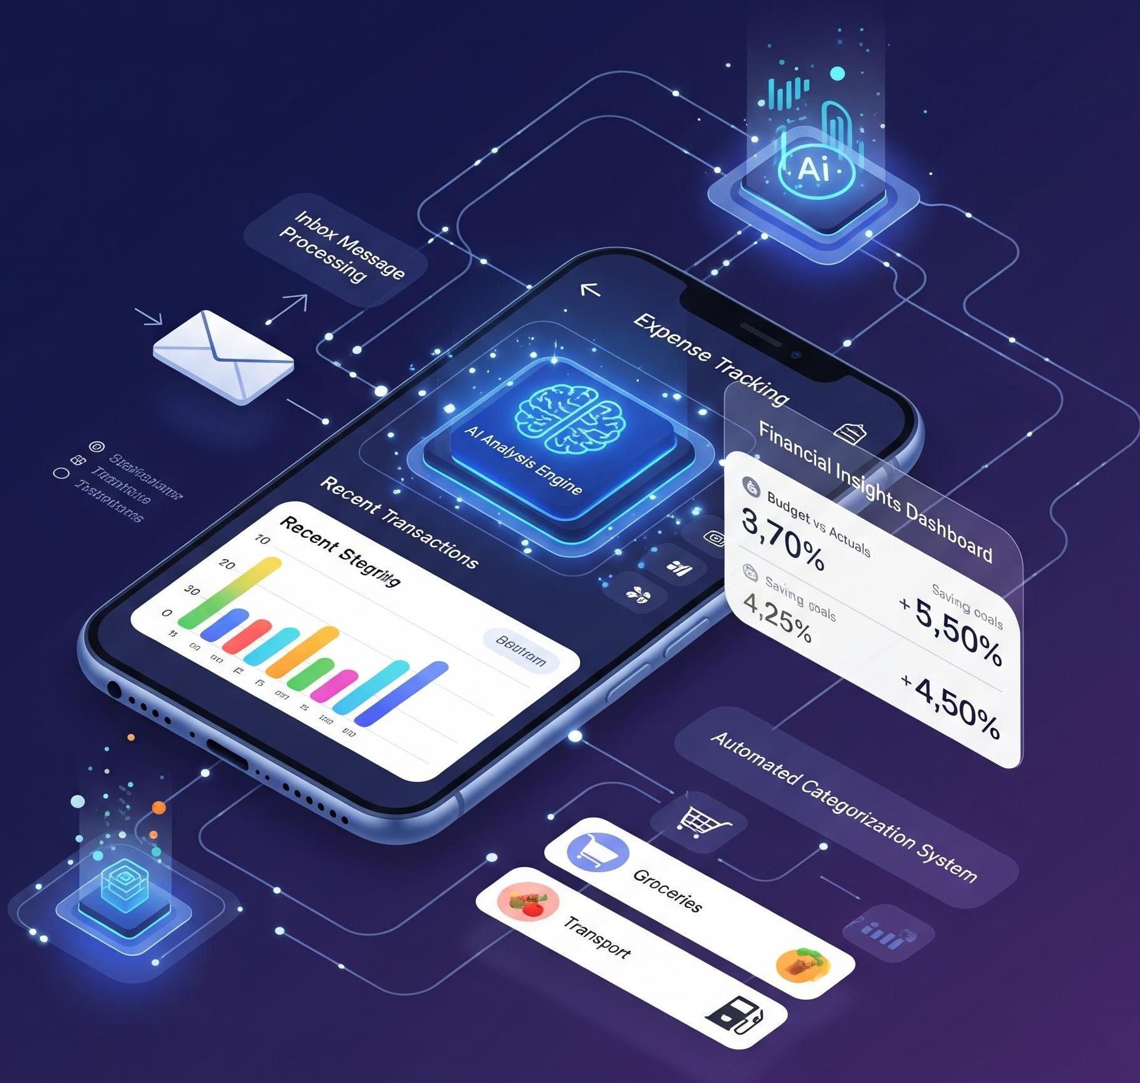
PROPOSED SYSTEM
FinSense AI provides continuous financial assistance.
It analyses transactions and spending behaviour in real time.
AI identifies financial opportunities and spending risks.
The system generates personalised investment nudges.
Users can act on savings opportunities through micro-investments.
Goal tracking and gamification provide continuous feedback.

Slide 9
PROPOSED SYSTEM FEATURES
Real-time transaction monitoring
Automatic transaction categorisation
Spending behaviour analysis
Overspending detection
Recurring expense detection
Savings opportunity detection
Personalised investment nudges
Micro-investment recommendations
Financial goal tracking
Streaks and milestones
Gamified savings
Adaptive motivation

Slide 10
LITERATURE REVIEW
Area | Method / Approach | Finding
Mobile Personal Finance | Expense categorisation | Good tracking but mainly reactive
Behavioural Economics | Nudge theory | Timely prompts can encourage better financial behaviour
Robo-Advisory | ML-based recommendations | Supports automated investment decisions
Fintech Gamification | Rewards and milestones | Improves user engagement
Real-Time Analytics | Stream processing | Enables immediate transaction analysis
Micro-Investment | Round-up / rule-based investing | Encourages small and regular investments

Slide 11
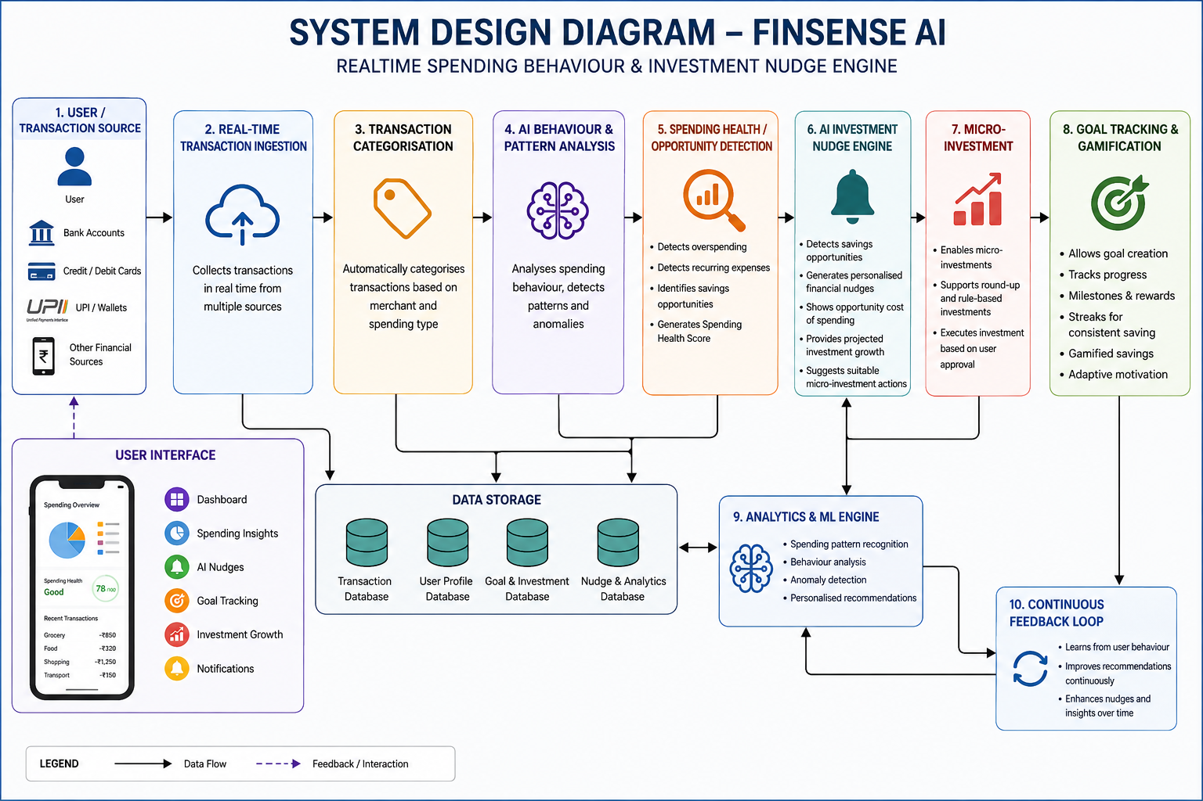
SYSTEM DESIGN

Slide 12
DATASET
The system uses transaction-level financial data.
Important data fields:
Transaction amount
Transaction category
Merchant name
Date and time
Spending frequency
Recurring transactions
User financial goals
Savings amount
Investment amount
Purpose:
Analyse spending behaviour
Detect spending patterns
Identify unnecessary expenses
Find savings opportunities
Generate personalised financial nudges

Slide 13
TECHNOLOGIES
Front End
User Dashboard
Spending Visualisation
Goal Progress
Nudge Notifications
Back End
Transaction Processing
User Management
Goal Management
Data Handling
AI / ML
Spending Pattern Recognition
Behaviour Analysis
Anomaly Detection
Personalised Recommendations
Tools
Database
Development Environment
Data Visualisation
Testing Tools

Slide 14
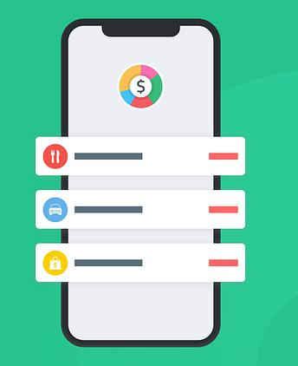
Module 1 – REAL-TIME SPENDING ANALYSIS ENGINE
Monitors incoming transactions in real time.
Categorises transactions based on merchant and spending type.
Analyses user spending behaviour.
Detects overspending and recurring spending patterns.
Identifies potential unnecessary or impulse expenses.
Generates a Spending Health Score.

Slide 15

Module 2 - AI INVESTMENT NUDGE ENGINE
Detects potential savings opportunities.
Analyses spending behaviour before generating suggestions.
Provides personalised financial nudges.
Shows the potential opportunity cost of spending.
Provides projected investment growth.
Suggests suitable micro-investment actions.

Slide 16

Module 3 – GOAL TRACKING & GAMIFIED SAVINGS
Allows users to create financial goals.
Tracks savings and investment progress.
Displays goal progress and milestones.
Provides streaks for consistent saving.
Uses rewards and milestones to improve engagement.
Provides adaptive motivation for long-term financial habits.

Slide 17

METHODOLOGY
Collect transaction data.
Clean and preprocess the data.
Categorise transactions.
Analyse spending behaviour.
Detect spending patterns and anomalies.
Identify savings opportunities.
Generate personalised AI nudges.
Calculate projected investment growth.
Record micro-investment actions.
Track financial goals.
Apply gamification and continuous feedback.

Slide 18
USE CASE DIAGRAM
The user can:
View spending analysis
View spending patterns
Receive AI investment nudges
View projected investment growth
Make micro-investment decisions
Set financial goals
Track goal progress
View milestones
Maintain saving streaks
System: FinSense AI processes transaction data and provides personalised financial guidance and recommendations.

Slide 19
RESULT AND DISCUSSION
The implemented system provides:
Real-time spending analysis
Automatic transaction categorisation
Identification of spending patterns
Detection of unnecessary expenses
Savings opportunity identification
Personalised financial nudges
Investment growth projections
Support for micro-investment decisions
Continuous financial-goal monitoring
Milestones and saving streaks
Overall Result: FinSense AI transforms personal finance from reactive expense tracking into proactive, behaviour-based financial guidance.

Slide 20
CONCLUSION AND FUTURE SCOPE
CONCLUSION
FinSense AI integrates real-time spending analysis, behavioural analysis and AI-based financial nudges.
It identifies spending patterns and potential savings opportunities.
The system encourages users to make small and regular investment decisions.
Goal tracking and gamification support consistent financial behaviour.
Overall, it helps users make more informed financial decisions.
FUTURE SCOPE
Advanced personalised ML models
Improved spending prediction
Integration with additional financial data sources
More advanced investment recommendations
Enhanced privacy and security
Intelligent financial goal planning
Improved behavioural prediction

Slide 21
REFERENCES
□
Thaler, R. H., & Sunstein, C. R. (2008). Nudge: Improving decisions about health, wealth, and happiness. Yale University Press.
Kahneman, D. (2011). Thinking, fast and slow. Farrar, Straus and Giroux.
Barber, B. M., & Odean, T. (2013). The behavior of individual investors. In Handbook of the Economics of Finance (Vol. 2, pp. 1533–1570). Elsevier. https://doi.org/10.1016/B978-0-44-459406-8.00022-6
Sironi, P. (2016). FinTech innovation: From robo-advisors to goal based investing and gamification. Wiley.
Gomber, P., Koch, J.-A., & Siering, M. (2017). Digital finance and FinTech: Current research and future research directions. Journal of Business Economics, 87, 537–580. https://doi.org/10.1007/s11573-017-0852-x
Hamari, J., Koivisto, J., & Sarsa, H. (2014). Does gamification work?—A literature review of empirical studies on gamification. In 2014 47th Hawaii International Conference on System Sciences (pp. 3025–3034). IEEE. https://doi.org/10.1109/HICSS.2014.377

Slide 22


